Slide 1
Comprehensive Sexuality Education (CSE)
What It Is and What It Isn't
Deus Lupenga
Ministry of Labour, Youth, Sports and Manpower Development

Slide 2
CSE 101
CSE stands for Comprehensive Sexuality Education
Predecessors to CSE were Family Life Education (FLE), Population Education, Life Skills
CSE is delivered through the frameworks of the
  ICPD Programme of Action (1994)
  ESA Ministerial Commitment on CSE and YFS (2013)
  UN International Guidance on CSE Vol 1&2 (2009)
  UNFPA Operational Guidance (2014)

Slide 3
CSE 101
  CSE: refers to curriculum based education that approaches sexuality and relationships with information that is
    Gender and rights-based
    Age appropriate
    Culturally relevant
    Scientifically accurate
    Realistic
    Non-judgmental

Slide 4
CSE 101
  Rights Based CSE include these core principles :
  Respect for human rights and diversity, with sexuality education affirmed as a right
  Critical thinking skills, promotion of young people’s participation in decision making, and strengthening of their capacities for citizenship
  Fostering of norms and attitudes that promote gender equality and inclusion
  Addressing vulnerabilities and exclusion
  Local ownership and cultural relevance
  A positive life-cycle approach to sexuality

Slide 5
CSE 101
What do we mean by Comprehensive?
  It refers to breadth and depth of the topics
  It implies that topics cannot be included or excluded at random. It is a package.
    Abstinence only until marriage is NOT an example of comprehensive sexuality education.
    Sexuality is not to be presented only as risk, danger, and ‘just say no’ but presented in a more balanced, realistic way

Slide 6
CSE 101
Lessons can be delivered in or out of school and are meant to give information to:
  increase knowledge and understanding
  explore and clarify values and attitudes
  promote healthy behaviors
  develop/strengthen life skills and
  promote and sustain risk-reducing behavior including health seeking behavior and links to health service

Slide 7
Key Concepts of CSE
Key Concept 1: Relationships Friendship, love, romantic relationships, parenting | Key Concept 2: Values, Attitudes and Skills Values, decision-making, communication | Key Concept 3: Culture, Society and Human Rights Sexuality, culture and rights, gender, sexual abuse and violence
Key Concept 4: Human Development Reproduction, Puberty, Bodily Integrity | Key Concept 5: Sexual Behaviour Sex, sexuality and the sexual life cycle; sexual behaviour | Key Concept 6: Sexual and Reproductive Health Pregnancy prevention, HIV and STI Risk Reduction, HIV Stigma and Care

Slide 8
Common Topics
Common life skills based CSE topics
Sex, sexuality, sexual rights and sexual behaviour
Gender
Puberty
Sexual and reproductive anatomy and physiology
Preventing Early and Unintended Pregnancy/Contraception/Family Planning
HIV Transmission, stigma discrimination and AIDS care and support
STIs
Risk reduction and safer sex practices
Correct and consistent Male and Female Condom Use
Relationships: friendship, love, sexual
  Multiple and Concurrent Partnerships
  Intergenerational Sexual relationships
Harmful Cultural Practices (child marriage, FGM, some initiation ceremonies)
Sexual and gender based violence (rape, sexual abuse, harassment, etc.)
Health seeking behaviour and youth friendly services

Slide 9
CSE 101
CSE is most effective when it is taught in an interactive, participatory way by teachers/facilitators who are well trained, comfortable with sexuality topics, and have supporting teaching and learning materials whether in formal classroom setting or in community based settings

Slide 10
CSE 101
CSE is implemented within ESA
  In schools through classroom instruction as
    a stand alone subject or
    integrated/infused in more than one carrier subject (biology, social studies, etc.)
    sometimes a compulsory subject, examinable or assessed
  In schools through extracurricular activities/clubs
  Out of school through community outreach, peer education, SBCC
Each of these implementation modalities have their own advantages and disadvantages

Slide 11
What are the myths and facts about CSE?
CSE does NOT
  Focus on sexual intercourse or encourage young people to have sex
  Teach young people how to have sex or take away their innocence
  Follow an abstinence only until marriage approach
  Disregard abstinence as an option
  Perpetuate myths about condoms
  Undermine parents or the authority of families
  Disregard nor impose cultural or religious values and morals
  Promote membership in sexual minorities (homosexuality, transgender, etc.)

Slide 12
Benefits of CSE:
Reduction of misinformation
Increased correct knowledge about sexuality, relationships and HIV
Clarified and strengthened positive/health promoting values and attitudes
Increased skills to make informed decisions and the self efficacy to act on them
Improved perceptions about peer groups and social norms
Increased communication with parents and other adults

Slide 13
CSE Impact
Extensive evidence shows that effective comprehensive sexuality education programmes paired with access to quality, youth friendly services consistently:
increase adolescents and young people knowledge of HIV and other health issues,
delay age of sexual debut,
decrease number of sexual partners and frequency of sex, and
increase use of contraception including condoms.

Slide 14
In Summary…
Young people face significant challenges to their sexual and reproductive health and realizing their full potential
CSE can reduce these vulnerabilities by building knowledge and skills that enable young people to reduce sexual risk behaviors and have healthier relationships
The education, health sectors, gender, youth sectors among others, have critical roles to play and tremendous opportunity to prepare adolescents and young people for leading sexually healthy lives
Access to the health promoting information within CSE is a right

Slide 15
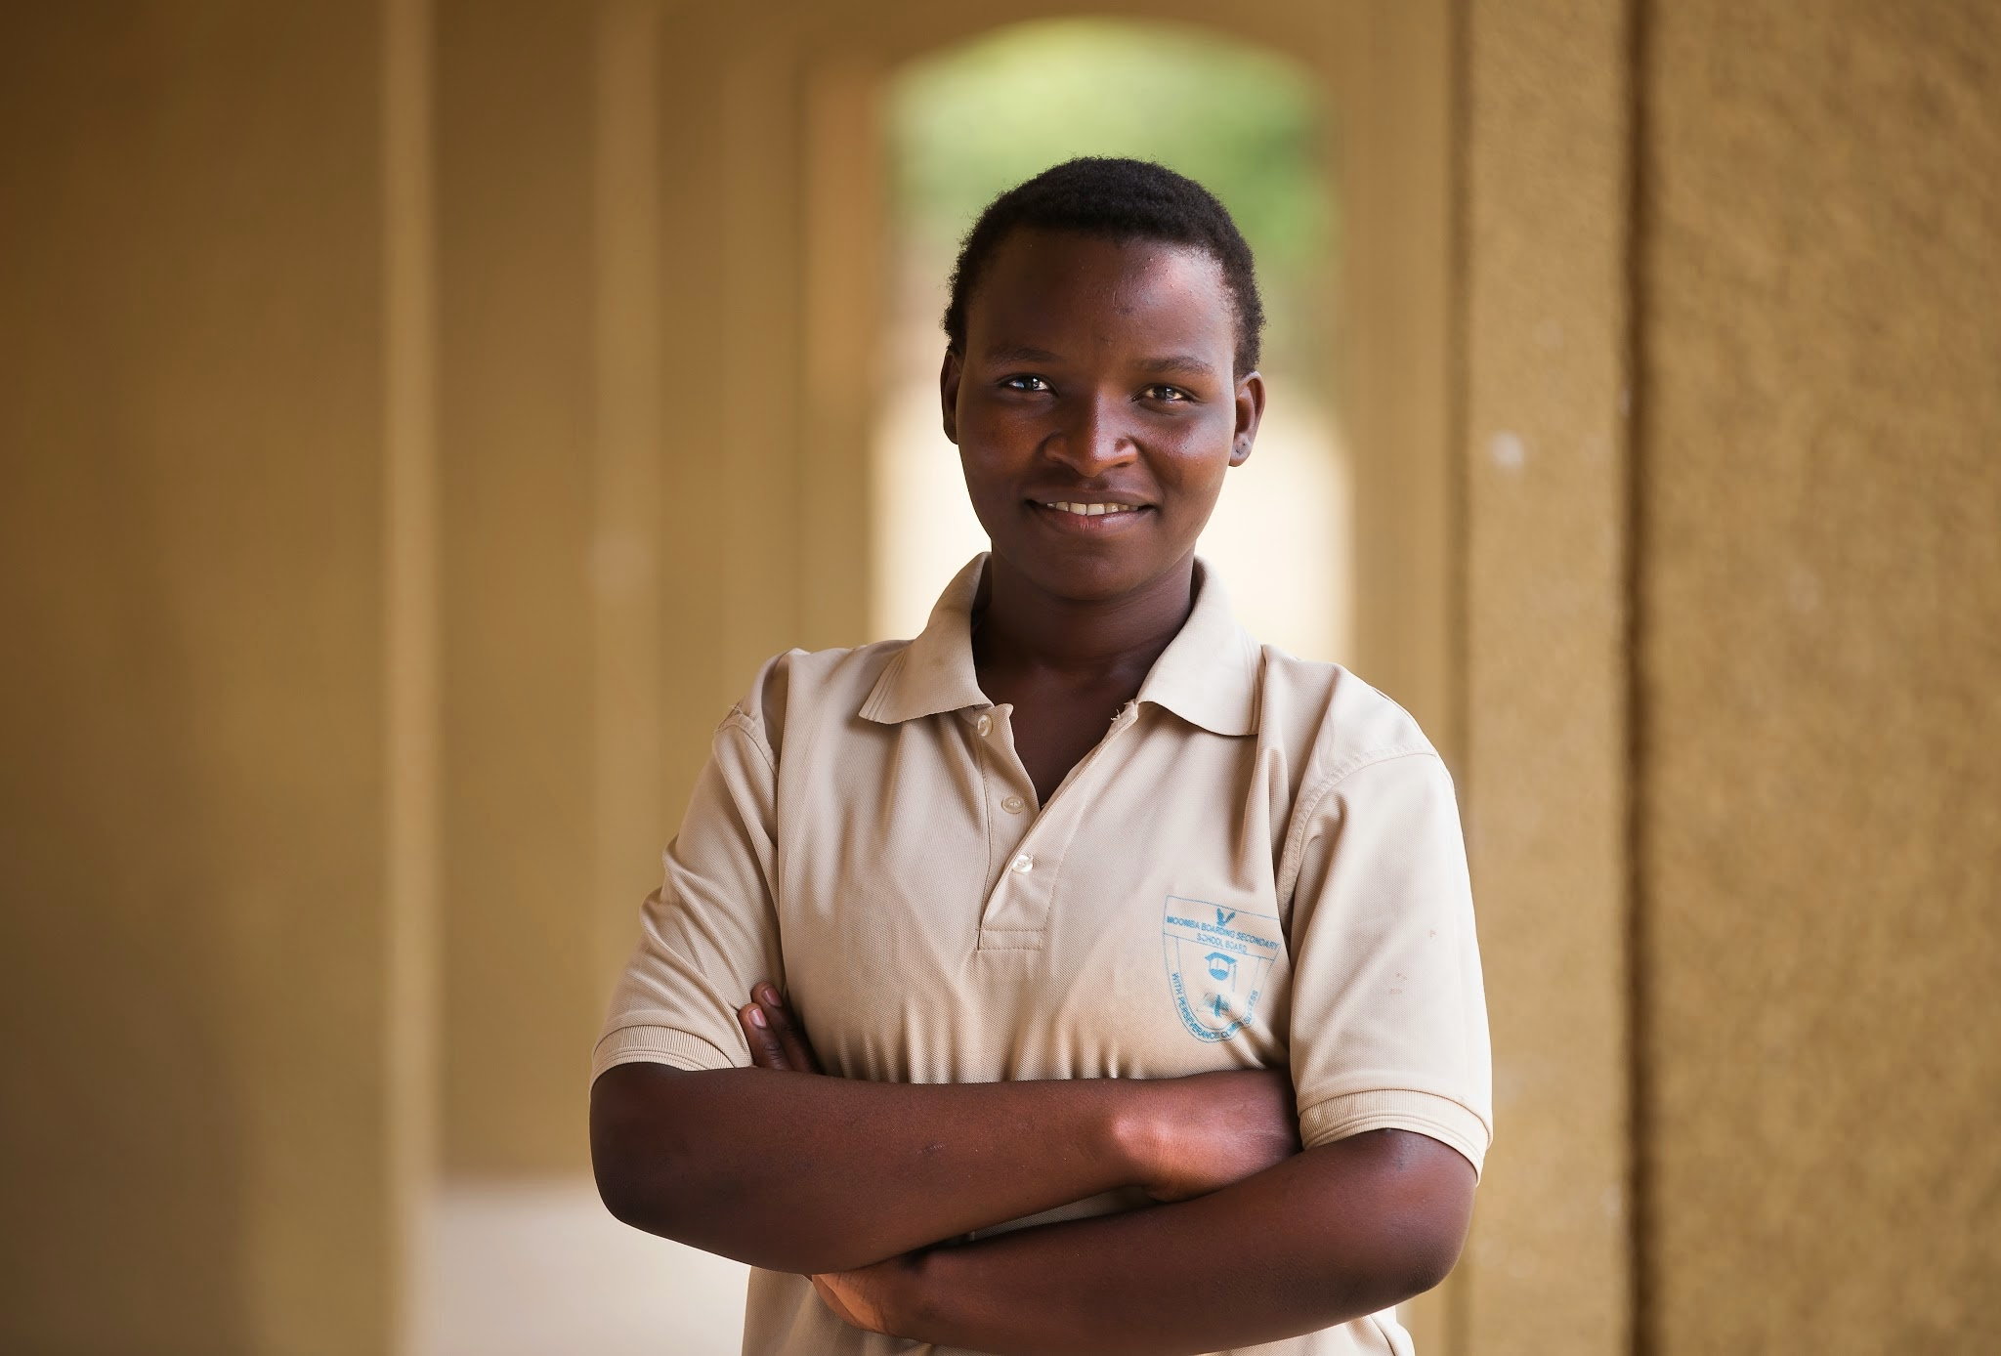
A young African, a global citizen who is empowered, educated, healthy, resilient and socially responsible - an autonomous decision-maker and has the capacity to reach their full potential and contribute to the development of their community, country and the region.
Notes:
At the heart of this is the vision of the young person
Health and education have different targets, perspectives, ways of working
What is needed is the development of a new language that all sectors can identify with, systems for working together effectively,
Define a common vision so that complementary action by the different sectors can be implemented to reach our common vision of a healthy educated etc. individuals.

