Slide 1
Comprehensive Sexuality Education for Out of School Young People
The Malawi Experience
Malawi

Slide 2

Who and Why?
  Who are out of school young people?
  Out of school young people include those that have never been to school, school leavers, or school going youth during holidays, weekends, etc.
  There are large numbers of out of school young people and often the most vulnerable and left behind (teen mothers, young married women, youth living with HV, youth with disabilities, young key populations, youth in detention etc.)
  Who Implements?
  Ministry of Youth and other Ministries, Youth Lead Facilitators, Youth Organizations, CSOs (like International and Local NGOs, Sports Clubs, Boy Scouts and Girl Guides, etc.), FBOs, Mother Groups. It is usually community based.

Slide 3
  Why?
  Out of school CSE is meant to complement and in many cases extend what is offered in schools
    complement in that we are all aligning the key messages consistently with International Standards; the content similar, sometimes the delivery is different
    extend what is offered in school because not limited to the 40 minute classroom period and can go in further depth per topic, opportunities to do and more comprehensive number of topics
    since many Schools do not allow condom demonstrations in classrooms, such demonstrations can take place in out of school CSE, also condoms and contraceptives may be available for those who want them
    some out of school CSE is more closely linked to health services such as youth organizations that operate from the health service delivery points, or clinic visits more feasible during out of school CSE sessions.

Slide 4
CSE Resource Package
  International Technical and Programmatic Guidance on OOS CSE
  CSE Programming Guide (also known as CSE Framework)
  Out of School CSE Manual (Facilitator’s Manual and Participant’s Workbook)
  TOT Facilitation Guide
  4 Pamphlets (Social Media Safety, YFHS, Human Rights and HIV testing)
  Male & Female Condom Demonstration kits
  iCAN Package (Manual & Workbook for YPLWHIV)
  SYP Edutainment Music Album and Music Videos
  TuneMe mobisite http://mw.tuneme.org
  “Breaking the Silence” - Manual for Young People with Disabilities (Aug 2021)
  Parent-Child Communication Manual (ready by March 2019)
  Amaze Videos

Slide 5
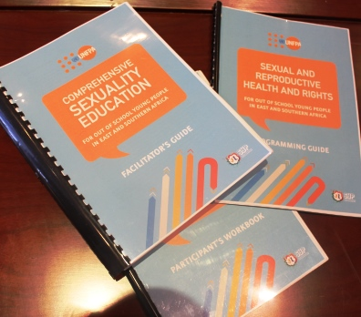

Slide 6
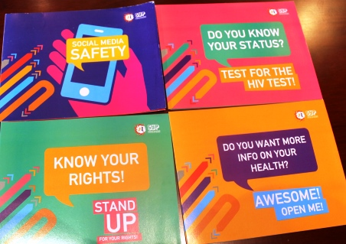

Slide 7
CSE Programming Guide/Framework
  Focuses on out of school youth programming broadly and can be considered a Framework
  Rationale for the focus on out of school young people & how it complements and extends in school CSE
  Key SRH issues for out of school youth
  Key behaviors to be addressed & programming options
  Guiding framework
    Sample education programmes
    CSE
    Youth Friendly Services
    M&E

Slide 8
Facilitator’s Manual
  Manual developed in response to the need to consolidate the many different teaching and learning materials being used in the SADC region and Malawi on CSE and for young people that are not in school.
  8 countries were asked to submit various CSE, Life Skills, HIV Prevention and Peer Education materials being used to inform the development of the current manual that is generally more comprehensive than many existing materials and helps promote a consistent set of key messages directed at young people out of school.

Slide 9
  Aligned with the international standards on CSE
  Address all the learning domains (cognitive/knowledge acquisition, affective/values clarification, and skills-building),
  Designed with participatory methodologies
  Activities are also purposely designed to be low tech (no PowerPoint!) and relatively inexpensive to accommodate facilitation in rural areas and situations not requiring electricity (although advance preparations may require some photocopying or use of some basic stationery supplies and music video viewing)

Slide 10
  3 Sections:
    Section 1, Who am I?
    Section 2, Where am I going?
    Section 3, How am I going to get there?
  It is through these sections that the flow of the content is sequenced and within these 3 main section are units that are delivered to youth.
  Activities. Each of these activities are presented in a form of a lesson plan that follow a similar format and end with key messages that summarise the most important information of the session.

Slide 11
Use of the manual is flexible and is to be customized accordingly.
Sample programmes provided according to the number of full training days possible when working with young people or training others in the use of the manual. There is also 2 different 10 day programmes: for 10-14 year olds and 15-20+ year olds.
TOT Facilitation guide developed to address quality assurance

Slide 12
Participant’s Workbook
Participant’s Workbook contains all the worksheets and information that participants need for the activities within the lesson plans (activities) in the Facilitators Manual.
It is used by the youth and includes the Key Messages that are found at the end of each Unit

Slide 13
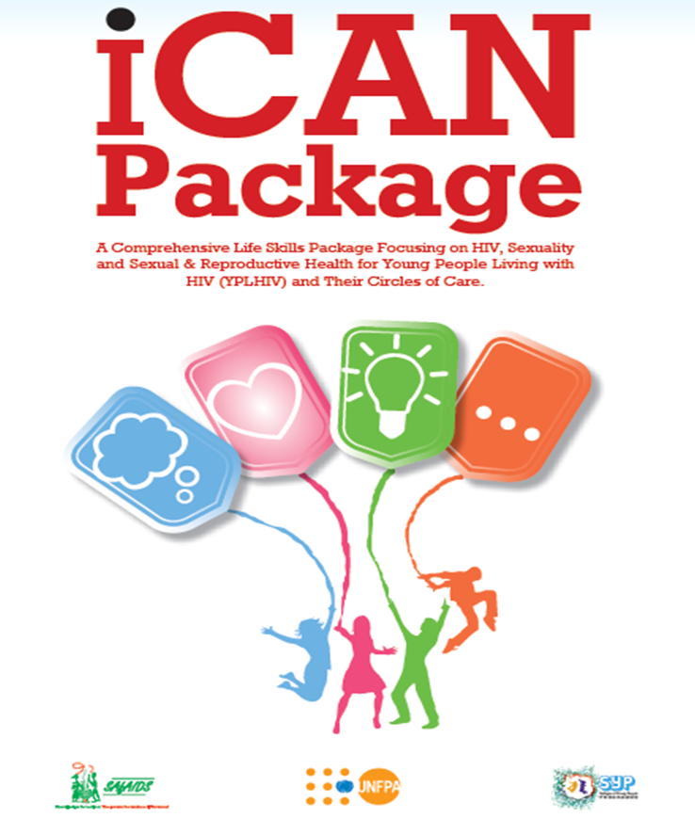
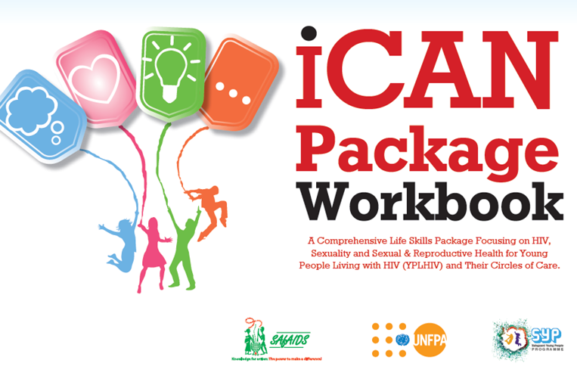
iCAN Package for YPLWHIV

Slide 14
iCAN package has been designed to support YPLHIV and those who work with them, to help them understand their HIV positive status and empower them to plan their lives in ways that protect both their own health and that of others.
The package can be utilized to complement existing materials focusing on SRH and HIV and other youth-focused packages produced by partners working with YPLHIV
It is suitable for use with young people in the following age groups: 10–14 years, 15–19 years and 20–24 years.

Slide 15
iCAN Modules
iPositive focuses on supporting YPLHIV to unpack ‘Who Am I?’, recognizing themselves and their environment, building their self-esteem, improving communication skills and decision making capabilities and, most importantly, building a self-concept that places their HIV status within the totality of their lives in a balanced way. ‘HIV does not define me!’

Slide 16
iAspire builds on the self-awareness explored in the iPositive module and focuses on ‘Where am I going?’ It is critical for all YPLHIV to see a healthy and productive future in front of them, just like all other young people. This module supports YPLHIV to unpack their dreams and aspirations, set life goals, including planning for their education, and to look critically at establishing and maintaining healthy relationships and behaviors that will help them get there. ‘HIV is just part of my journey!’

Slide 17
iProtect asks ‘How will I get there?’ and focuses on empowering YPLHIV to realize their SRH and rights, take responsibility for their future, their health and that of their loved ones – no onward transmission and avoiding common challenges by seeking information and services such as HIV testing, condoms, contraception, ARVs and prevention and treatment of opportunistic infections that can hold back a planned future. They will aim for no reinfection: ‘HIV ends with me!’

Slide 18
iAction is the final module. It asks ‘What can I do?’ and urges YPLHIV to self-actualize their dreams. One way is to become champions for change. Every young person living with HIV has something to offer their fellow YPLHIV and others at home, in the community and beyond. ‘I can make a positive difference!’

Slide 19
Edutainment Music and Videos: We Will Album
  Music artists nominated by young people in their countries volunteered to be part of this project
  They were trained in CSE basics and developed lyrics and videos in English and local languages based on some of the prevalent issues in their countries
  Topics include: Early marriage, Sexual abuse, Unintended pregnancy, HIV and STIs, relationship, sexual rights and responsibilities, youth friendly health services, multiple and concurrent partnerships, male and female condom use, contraception, love.

Slide 20
Track List
Rudo by Bryan K (Zimbabwe)
Give Me a Chance by All
Jack and Jill by KrTC (Swaziland)
Just Us by Zeus (Botswana)
Hereeng by Stlofa (Lesotho)
Busi by DJ Kaliwa (Zambia)
Chimanga by Gwamba (Malawi)
Conjiva (Condom) by Stlofa, Gwamba and Zeus
Private Party by Bryan K, KrTC and DJ Kaliwa
We Will by All

Slide 21
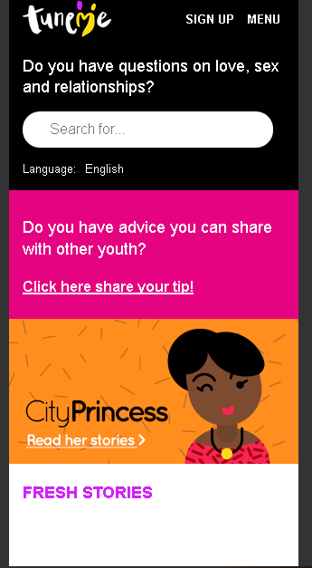
TuneMe: http://mw.tuneme.org

Slide 22
TuneMe Menu
Find a Service (Clinic Finder)
Hot Topics
True Stories
Your Body (Basics)
Sex (Sex Talk 101)
Relationship (All About Love)
Your Tips (Share Advise)

Slide 23
Delivery Methodology
Community based
  Youth Lead Facilitators
  YFHS Corners
  Youth Organisations and Networks
  Other Community Based Structures
Online
  TuneMe
  Facebook
  Online portals

Slide 24
Conclusion
Lessons are meant to give information to:
  increase knowledge and understanding
  explore and clarify values and attitudes
  promote healthy behaviors
  develop/strengthen life skills and
  promote and sustain risk-reducing behavior including health seeking behavior and links to health services

Slide 25


